Slide 1

Analysing Qualitative Data
Dr. Michael Agnew & Dr. Cherie Woolmer
MacPherson Institute

Slide 2
Analyzing qualitative data
Grounded Theory: used in the social sciences (both in qualitative and quantitative research) to generate theory from a deep and rigorous analysis of the data
Structured Coding: will typically begin with a list of codes or keywords according to the aims of the research/questions being asked
Descriptive/Open Coding: codes generated only as one reads through and analyzes the data, looking for common emerging themes

Slide 3
Thematic Analysis
Bryman (2004/2008) suggests:
Stage 1: Reading the text as a whole
Stage 2: Reading and marking the text (emerging keywords/codes)
Stage 3: Coding the text and grouping the codes to themes
Stage 4: Relating themes to the literature/theory
Videos: https://www.youtube.com/watch?v=7X7VuQxPfpk&t=17s
https://youtu.be/B_YXR9kp1_o

Slide 4
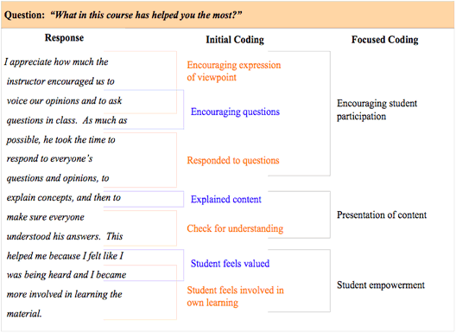
Coding data

Slide 5
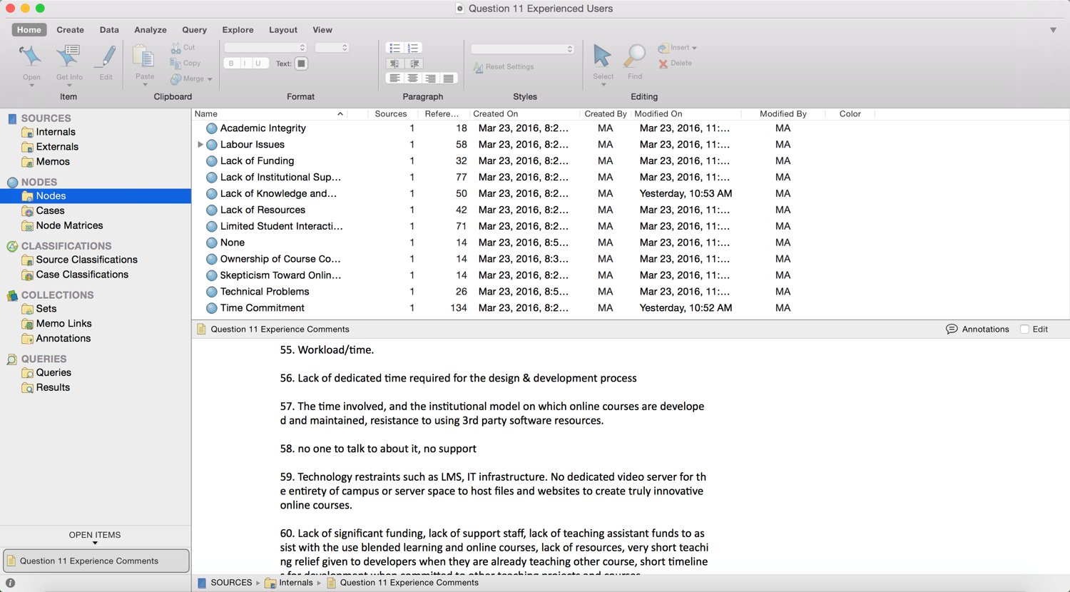
Analyzing large quantity of data (Nvivo)

Slide 6
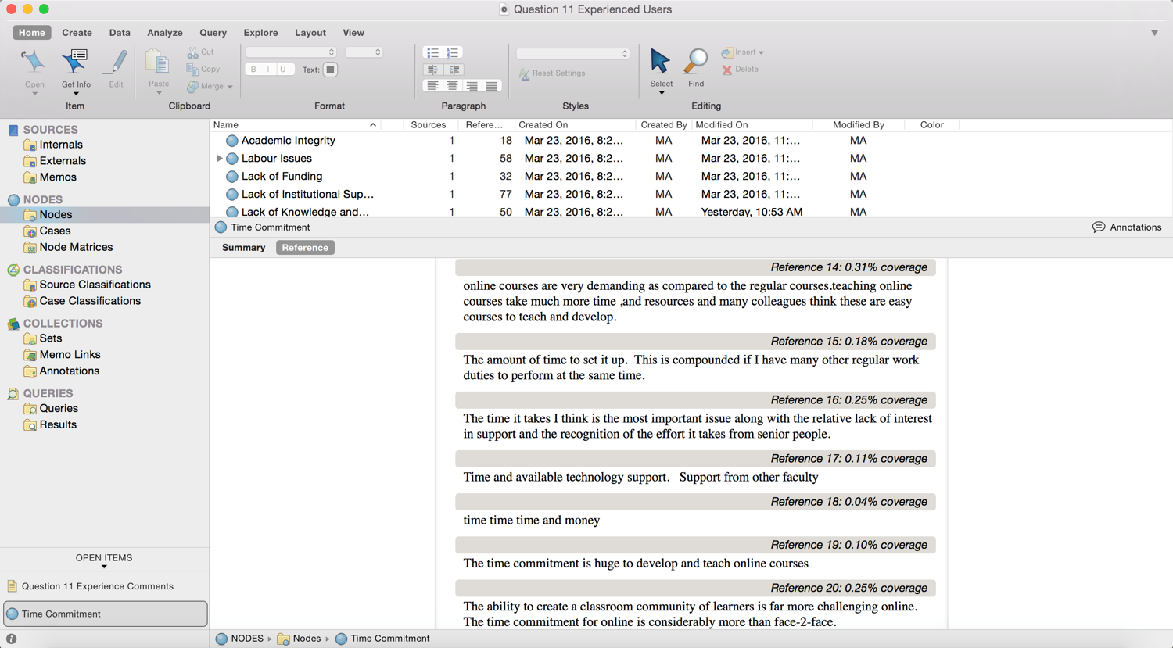
Analyzing large quantity of data (Nvivo)

Slide 7
Ensuring rigour through analysis
Notion of trustworthiness rather than validity and reliability (used in quantitative studies)
Know the data – listen, read, and re-read
Iterative process- how do codes link with literature and your research questions?
Be explicit about your own biases (positionality) and how these effect your interpretation
Cross-check themes with others analyzing the same data

