Slide 1

Designing, Conducting, and Analysing Focus Groups
Dr. Michael Agnew & Dr. Cherie Woolmer
MacPherson Institute

Slide 2
What is a focus group?
A method in which one or two researchers and several participants meet as a group to discuss a given research topic
One researcher (the moderator) leads the discussion by asking participants to respond to open-ended questions, a second (the note-taker) records the general themes participants discuss
A focus group ideally will have 6-10 participants, typically 1-hour in duration

Slide 3
Pros and cons of focus groups
Advantage of focus groups is they can elicit a wide range of perspectives from several participants in short timeframe
Also allows participants to form new perspectives or insights from the interplay with other focus group members
Focus groups not appropriate for highly personal or socially contentious issues

Slide 4
Ethical considerations
Before you begin the focus group you must obtain informed consent from all participants
Explaining purpose of the study, organizations sponsoring the research, how the data will be used
While impossible to ensure complete confidentiality, any information collected should be anonymous (pseudonyms, ID numbers, etc.), and the “Vegas rule” enforced
All mobile devices should be turned off

Slide 5
Developing good focus group questions
The key to conducting successful qualitative research with useful data is the development of good questions
Questions should be open-ended, semi-structured, and should not lead the participant
While a research protocol will have a set list of focus group or interview questions, there should be room for flexibility depending on responses of participants

Slide 6
Developing good focus group questions
Sounds conversational
Uses words participants would use
Clear and easy to understand
Short and to the point
Open-ended
Are one-dimensional
Scale your questions
  Engagement
  Exploration
  Exit

Slide 7
How to prepare for a focus group
Know the research material well:
Review the informed consent documents
Be familiar with the questions being asked, the purpose behind them, and be prepared to answer questions about the study
Practice moderating a focus group with fellow researchers/friends+family

Slide 8
How to build rapport in focus groups
Be friendly, smile, make eye contact with participants
Use relaxed body language, incorporate humour where appropriate
Be patient and do not rush participants as they answer
Be equally respectful of each participant’s contributions
Ensure participants treat one another with respect

Slide 9
Tips for moderating focus groups
Lay down the ground rules of the focus group before it begins
Invite a wide range of commentary: If there appears to be group consensus on a certain question, ask “Does anyone have another point of view/see it differently?”
Use silence to your advantage: Give participants a chance to think about their responses

Slide 10
Tips for moderating focus groups
Limit your own participation: pose a question and then let participants respond with limited direction/commentary
Encourage maximum participation: make sure all participants have a chance to respond, asking less vocal participants directly if they would like to contribute

Slide 11
Analyzing focus group data
Grounded Theory: used in the social sciences (both in qualitative and quantitative research) to generate theory from a deep and rigorous analysis of the data
Structured Coding: will typically begin with a list of codes or keywords according to the aims of the research/questions being asked
Descriptive/Open Coding: codes generated only as one reads through and analyzes the data, looking for common emerging themes

Slide 12
Thematic Analysis
Bryman (2004/2008) suggests:
Stage 1: Reading the text as a whole
Stage 2: Reading and marking the text (emerging keywords/codes)
Stage 3: Coding the text and grouping the codes to themes
Stage 4: Relating themes to the literature/theory
Videos: https://www.youtube.com/watch?v=7X7VuQxPfpk&t=17s
https://youtu.be/B_YXR9kp1_o

Slide 13
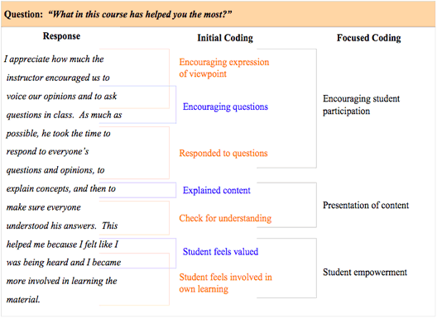
Coding focus group data

Slide 14
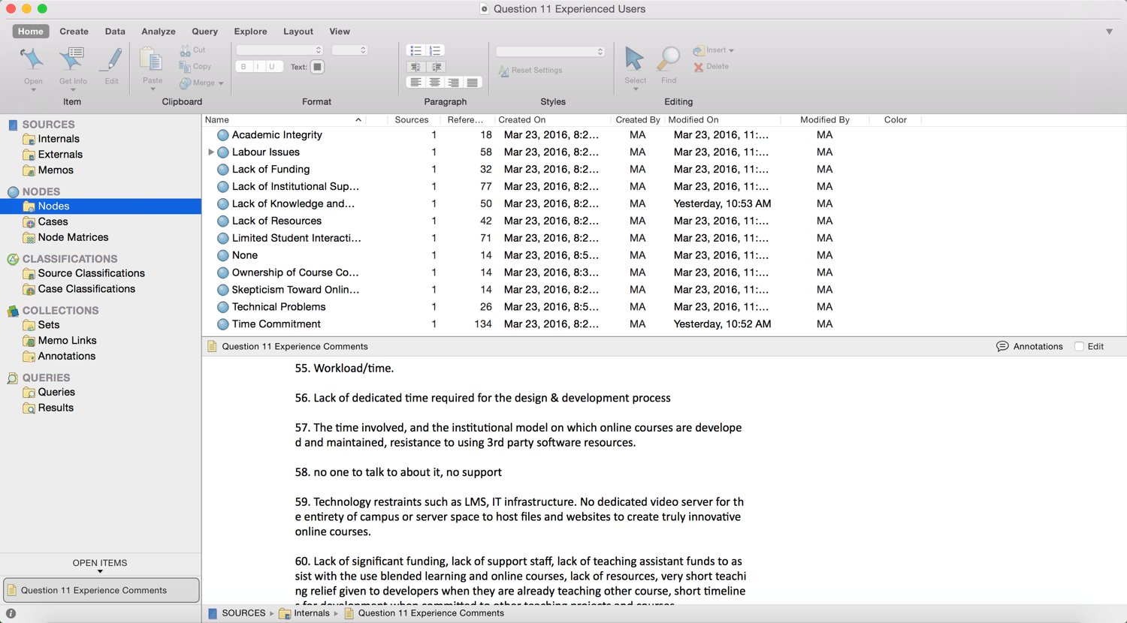
Analyzing focus group data - NVivo

Slide 15
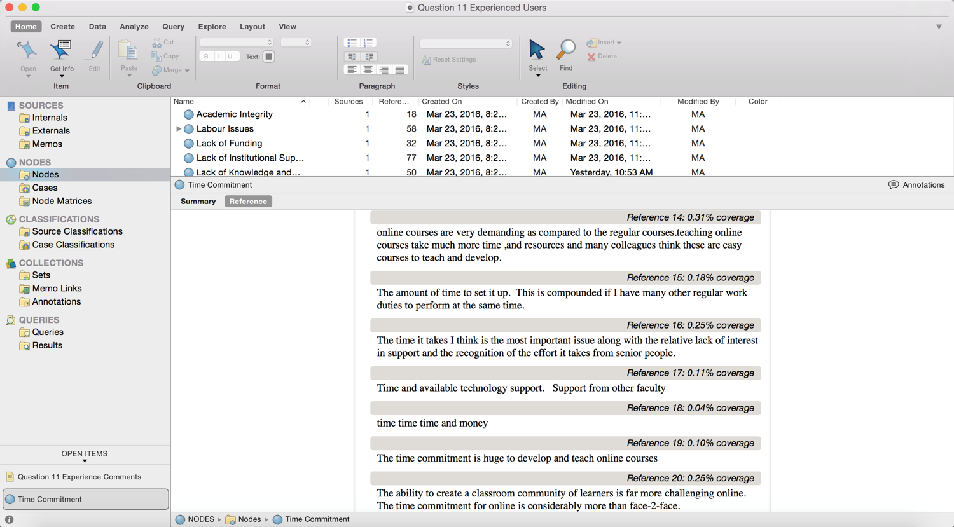
Analyzing focus group data- NVivo

Slide 16
Ensuring rigour through analysis
Notion of trustworthiness rather than validity and reliability (used in quantitative studies)
Know the data – listen, read, and re-read
Iterative process- how do codes link with literature and your research questions?
Be explicit about your own biases (positionality) and how these effect your interpretation
Cross-check themes with others analyzing the same data

