Slide 1

Literature Reviews and You!
Dr. Michael Agnew
MacPherson Institute
February 7, 2017

Slide 2
What brings you here today?
Before we begin, let’s take a moment to share with one another…
  A little about yourself (program, year, where you’re from!)
  The project you’re working on as a student partner
  What you hope to get out of the workshop today/how it might be relevant to your project

Slide 3
What is a literature review?
Surveying the literature is necessary because scholarship is cumulative
Your own original research contribution must be situated within the context of what has already been published
In short, a literature review considers the state and progress of existing literature on a given topic by organizing, integrating, and critically evaluating published books and articles

Slide 4
A literature review should…
Place your study within the context of other work
Inform your reader about the theories your research is based on
Define terminology and concepts drawn upon in your study
Explain the basis of your chosen research methodology
Establish the need for your research, identifying gaps/limitations

Slide 5
A literature review should not…
A literature review is not the same as an annotated bibliography
A literature review can build on the work done in an annotated bibliography, but includes a critical analysis of the relationship among different works, and relates the research to your own work

Slide 6
Reviewing the literature…
Where do I start?
Any literature review begins with a comprehensive search of existing scholarly publications
Start with broad descriptors (ex: online assessment), and then begin to narrow your focus to your research questions (ex: academic integrity online assessment)
The bibliographies of the articles you find will be helpful in pointing you to other sources, especially “classics” in the field and those most cited

Slide 7
Reviewing the literature…
Where do I start?
There are several citation management systems that can be used to store and organize your research (Mendeley, Zotero)
An effective literature search:
Reduces time spent looking for information
Maximizes quality and appropriateness of results
Helps clarify the scope of your topic
Helps define and refine the research questions
Helps identify experts in the field
Provides examples of successful methodologies

Slide 8
Reviewing the literature…
Reading effectively
As a starting point, focus on the general purpose and content of each article, zeroing in on the abstract, introduction, first few paragraphs, and conclusion
Develop a note-taking system (note cards, charts, Excel spreadsheets, the note-taking function in Mendeley, etc.)
Group the publications into categories and subcategories, based on general theme, methodology, population, etc., and order chronologically

Slide 9
Reviewing the literature…
Reading effectively
Identify key definitions/concepts that seem important to the field, and differences in how scholars use them
Note the strengths and the limitations of the study, the purpose of the review is not only to summarize but critically evaluate the lit.
Identify major trends or patterns, connections and gaps in the literature
Know when you’ve reached “literature saturation” and begin writing your review

Slide 10
Reviewing the literature…
Summarizing and organizing your review
Using a table can help to organize and most importantly synthesize your review findings
This is often called a “synthesis matrix”, which can take many forms
Most matrixes will organize the literature chronologically, and according to dominant themes and concepts, research methods, and will include a summary of the results

Slide 11
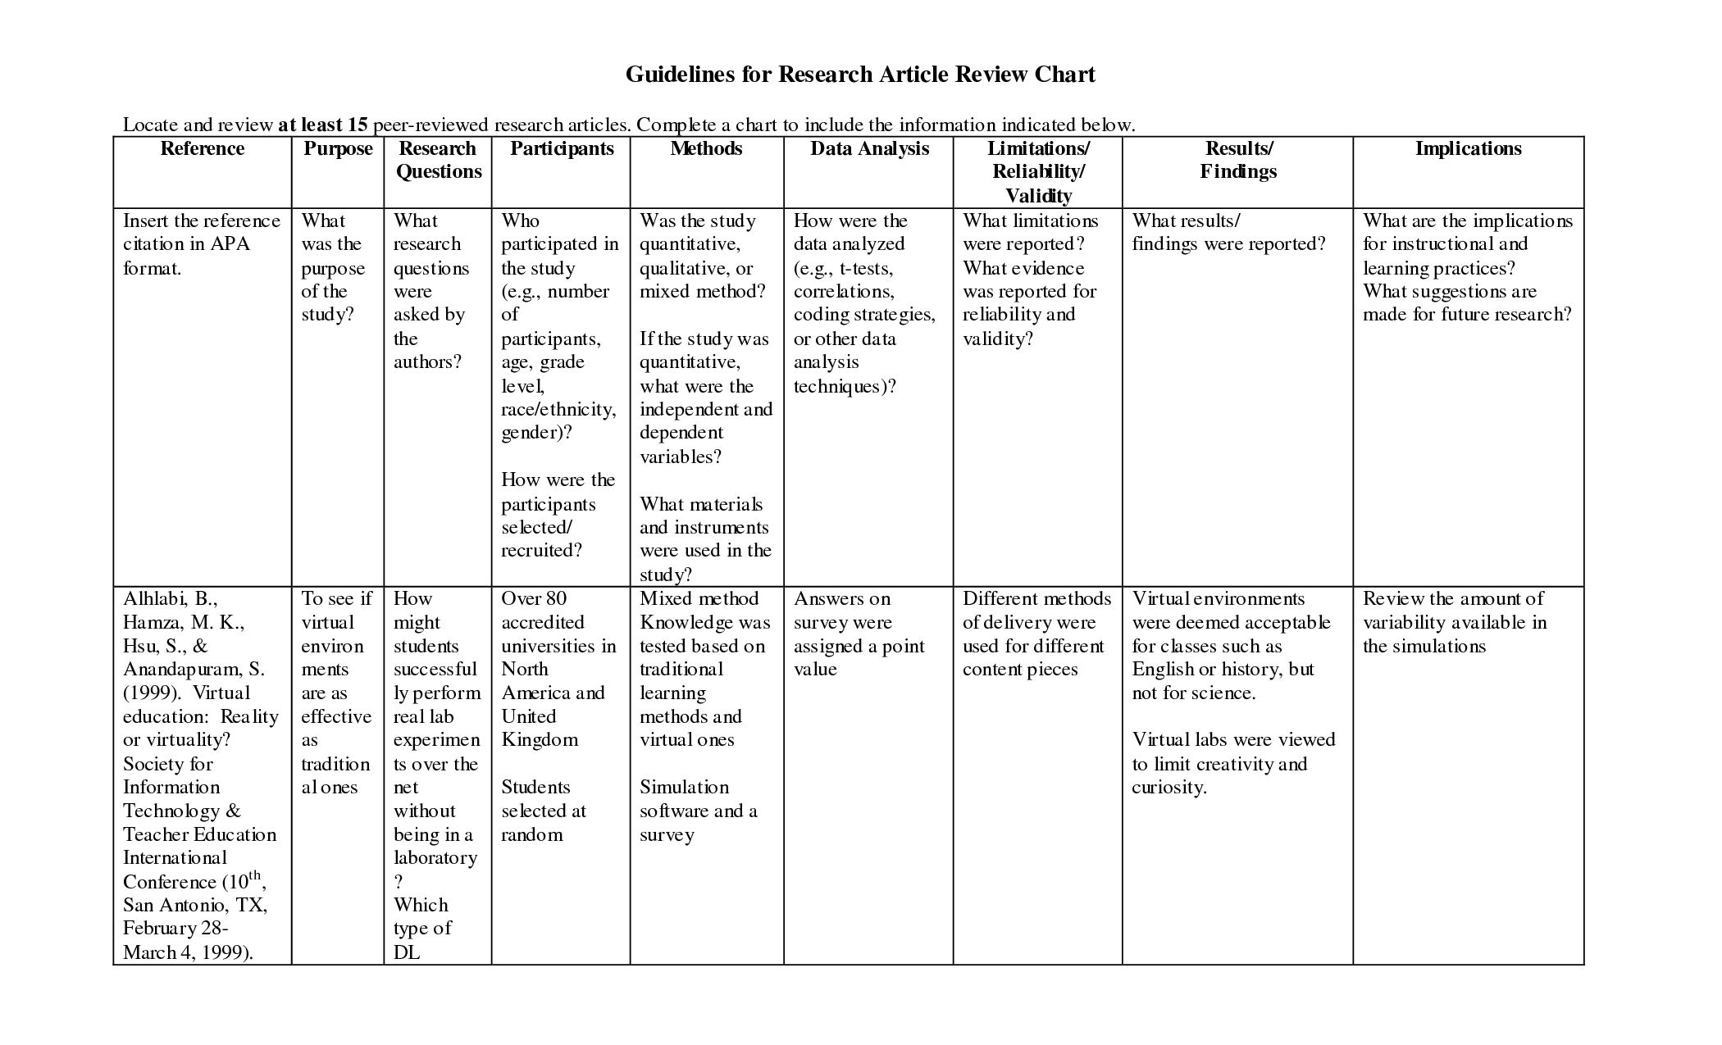
Reviewing the literature…
Synthesis Matrix

Slide 12
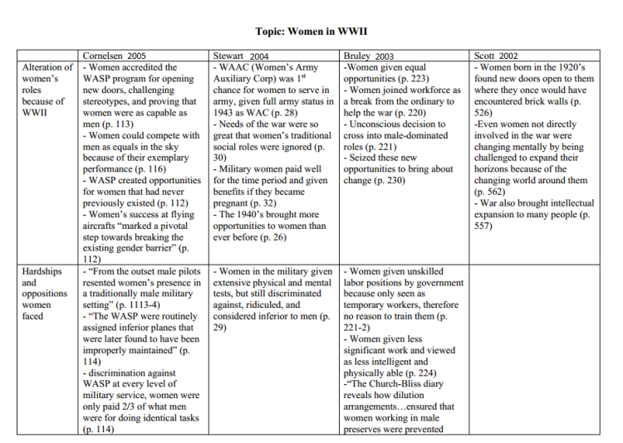
Reviewing the literature…
Synthesis Matrix

Slide 13
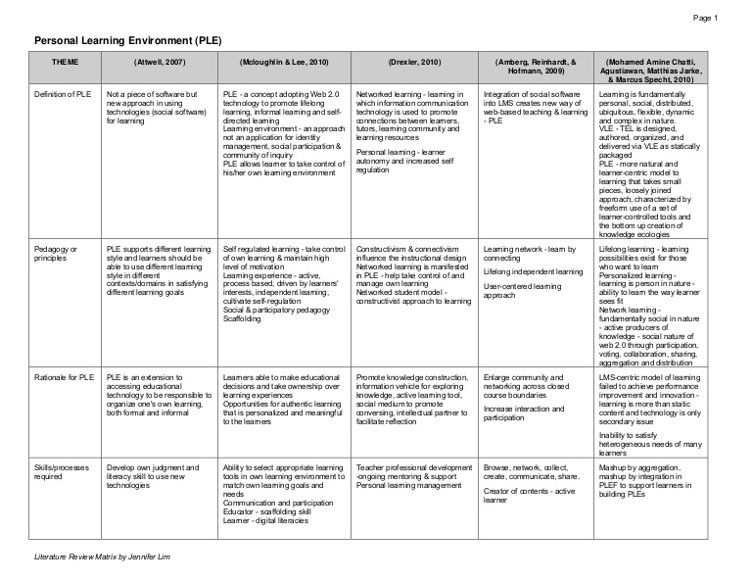
Reviewing the literature…
Synthesis Matrix

Slide 14
Reviewing the literature…
Preparing to write your review
Create a topic outline that traces your synthesis of the literature
Within each topic heading, note differences among the studies, how they build on one another, gaps in the field
Identify the theories, quotes, key definitions from your review you plan to incorporate into the review
Plan to discuss conclusions/implications of your review, and directions for future research

Slide 15
Reviewing the literature…
Tips for writing the review
Identify the broad problem area, and why the topic being reviewed is important, timely
Indicate why certain studies are important, and if they are considered classic or landmark in the field say so
Avoid long lists of nonspecific references
Highlight the chronological development of the field of literature
Be consistent in your citation

Slide 16
Reviewing the literature…
Examples
When looking at the two examples of lit. reviews, discuss the following questions:
How are they similar?
How are they different?
How do they organize their sources?
What is emphasized?
How are the sources synthesized, and what level of analysis is given to them?

Slide 17
Thanks for Coming!
Contact: agnewmj@mcmaster.ca

